Slide 1


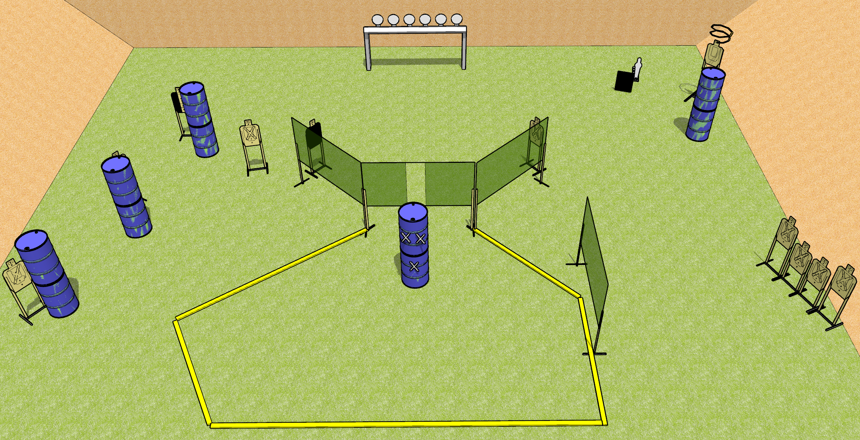
 | Dothan Gun Club – USPSA Match Mucking About Course Designer : Drew Coleman
START POSITION : Standing with both hands palms flat on marks on barrel. PCC muzzle touching mark.
GUN READY CONDITION : Pistol loaded and holstered. PCC shouldered, muzzle touching mark |  | SCORING: Comstock, 29 rounds TARGETS: 11 paper, 7 Steel SCORED HITS: Best 2 on paper, steel until down START-STOP: Audible, last shot RULES:
STAGE PROCEDURE: Engage targets as they become available from within the fault lines

